Slide 1
Water-Fill Technique for Inverted Text Images
Jithin Thenasseril
CS 583 Computer Vision
https://github.com/jpt44/water_fill

Slide 2
Problem Statement
Companies want to extract text data from large volumes of document images using Optical Character Recognition (OCR)
OCR requires that documents be oriented correctly. Current OCR solutions, such as Tesseract-OCR, can’t always detect the orientation of inverted (upside down) text
Incorrect orientation detection leads to incorrect text extraction

Slide 3
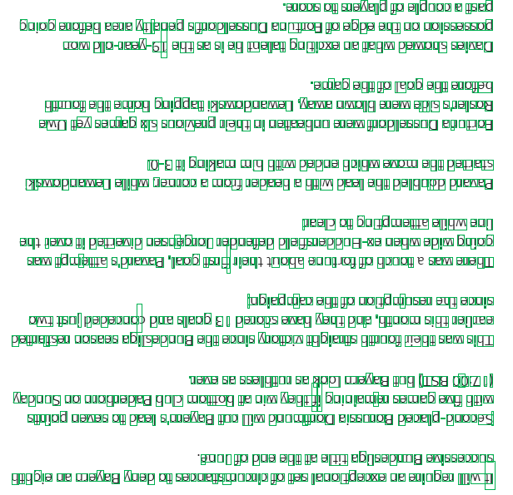
Pre-Trained Tesseract-OCR Results cont.
“3409S 0} S19AR]d $0 B]dNOD eB }sed
Bulob a1oyaq eare AyJeUad s4uopjassng euN04 Jo a6pa ay} uo uoIssassod
om pjo-seeK-6 | 84 SE SI ay UBTe} BUN!xe Ue JeYM pamoys saINeq
-awreb aug jo 106 ayy a10jq
yynoy ayy awuoy Buiddez pjsmopuemey ‘Keme umo]g 219M apis S,131S0Y
am ef sawreb xis snomaud sayy ul UayeaquN a10M Juopjassng eUuNz04
“0-€ 11 BupyeW WY YAM Papua Y>IyM ano ayy PALES
P{SMOPUEMET STIYM UUIOD & WO. Jepeay e YIM pes] By} palqnop pieneq
“reap 07 Bundwaze ayy aun
By} 19N0 31 pazaAIp UasUAab.or JapUajap PlayS/appnH-xe uaym apim Bulob
sem ydwiane s,prened ‘1206 1S4y, 4184} NOE aUNz 0} Jo YoNo} SEM a/OYL
-uBjedure> aug jo uonduinsas ay a2uis
om ysnf papa2uo> pur s]e0b € 1 paiors aney Aayy pure ‘YRUOW SIL JANES
paz1e3s91 uoseas eblsapung ayy aruIs 410,21 7YBres3S YyINO| O42 SEM SIL
“Jana Se ssayyyns se yO] Wakeg Inq (1S@ 00:L1)
Aepuns uo wioqseped qn} woyog 7e ulm Aayp JI BUIUTeWIe! SeWeD any URN
squiod uanas 07 pea} s,usefeg yn> IM puNwy.JOg eIssniog pare|d-puors,
‘une Jo pus ayy ye a3 eBNsapung anisseDons
UnyBie ue WaAeg Auap 03 saouezstuNd119 Jo 39s }eUONdadxa Ue axINbes TIM 3
Actual Skew Degree | # of Errors including spaces, punctuation | Accuracy (%) | Total # of Characters with spaces, punctuation | # of Errors from 0 degree that also existed here | Tesseract Detected Orientation (psm=0) | Orientation Confidence
0 | 4 | 99.64 | 1125 | NA | 0 | 0.14
270/90 | 7 | 99.38 | 1125 | 4 | 270/90 | 1.66
180 | 1125 | 11.39 | 1125 | 4 | 0 | 1.47

Slide 4
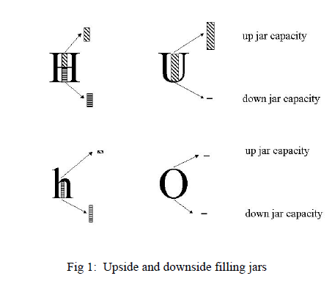
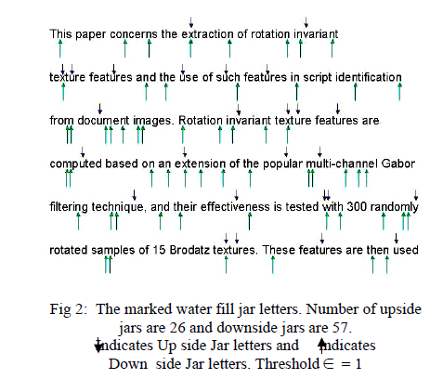
Water-Fill Technique
Specifically for English letters and digits (A-Z, a-z, 0-9)
See how much ‘water’ a character can hold (concavity)
Calculate up-jar and down-jar capacities
If sum of down-jar capacity (D) >2x up-jar capacity (U), the image is scanned upright.
Source: Pilevar and Ramakrishnan
Source: Pilevar and Ramakrishnan

Slide 5
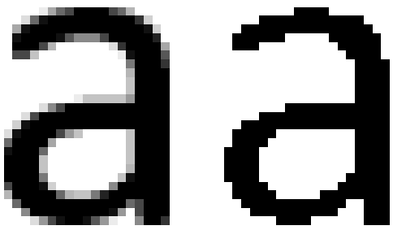
Concavity Calculation Method
Use Tesseract-OCR to isolate letters in grayscale text image (Tesseract-OCR not-author specified)
Extract and threshold character for binarization
Calculate concavities (up, down, left, right) of character using polynomial regression. Left/right concavities and polynomial regression were not specified by the authors. (left/right for C, E, F)
Add calculated concavities to up/down total capacities (left added to up, right added to down)
Repeat steps 2-5 for all characters
If down capacity >= 2.5x up capacity, document is upright, else it’s inverted

Slide 6
Water-Fill Results
It will require an exceptional set of circumstances to deny Bayern an eighth
successive Bundesliga title at the end of June
Second-placed Borussia Dortmund will cut Bayern’s lead to seven points
with five games remaining if they win at bottom club Paderborn on Sunday
(17:00 BST) but Bayern look as ruthless as ever.
This was their fourth straight victory since the Bundesliga season restarted
earlier this month, and they have scored 13 goals and conceded just two
since the resumption of the campaign.
There was a touch of fortune about their first goal, Pavard's attempt was
going wide when ex-Huddersfield defender Jorgensen diverted it over the
line while attempting to clear.
Pavard doubled the lead with a header from a corner, while Lewandowski
started the move which ended with him making it 3-0.
Fortuna Dusseldorf were unbeaten in their previous six games yet Uwe
Rosler's side were blown away, Lewandowski tapping home the fourth
before the goal of the game.
Davies showed what an exciting talent he is as the 19-year-old won
possession on the edge of Fortuna Dusseldorf penalty area before going
past a couple of players to score.
Actual Skew Degree | # of Errors including spaces, punctuation | Accuracy (%) | Total # of Characters with spaces, punctuation | # of Errors from 0 degree that also existed here | Tesseract Detected Orientation (psm=0) | Orientation Confidence
180 | 4 | 99.64 | 1125 | NA | NA | 0.14

Slide 7
Future Work
Different fonts, handle figures
Test more skews
Implement thresholding algorithm
Seam carving for resizing

